Slide 1
Bitcoin Mechanics
History of money & cryptography in bitcoin

Slide 2
outline
History of money
Byzantine General Problem
Cryptography in bitcoin
Hash
Digital signature

Slide 3
About Bitcoin
“We don‘t own any, we’re not short any. We‘ll never have a position in them.“ --Warren Buffett

Slide 4
History of money
Bitcoin is the first of the cryptocurrencies
Not likely to be the last
It also uses the block chain approach for distributing work
It is a decentralized, digital currency without bank or national support
First we should consider the general notion of currency

Slide 5
History of money
Prior to currency, but not yet completely absent, was the barter system
You and I both had something the other wanted
Usually things we grew or produced
We would trade this for that and we both met our needs
The exchange rate was built on perceived value

Slide 6
History of money
Why do we value gold or silver?
They are uncommon – small supply
They are durable – these are metals that do not rust or corrode very much
Unlike most other metals
The shiny surface is attractive
They are malleable – easy to make into useful shapes
The stuff of the first coins

Slide 7
History of money
Money needs to be:
Portable
Generally accepted medium of exchange
For most of history precious metal coins were the dominant form of money
Of course other things have been used

Slide 8
History of money
Large quantities of coins are needed for large purchases
The development of paper money simplifies the transport
First paper notes are 7th century in China
Reaches Europe by 13th
Described in The Travels of Marco Polo

Slide 9
History money
Commodity money
Something which is intrinsically valued such as gold, shells, spices
Fiat money
A government requires this form to be accepted as legal tender
Fiduciary money (stock)
Depends on the confidence of people that it will be accepted
Commercial bank money
Based on the promise that a bank will exchange for other form

Slide 10
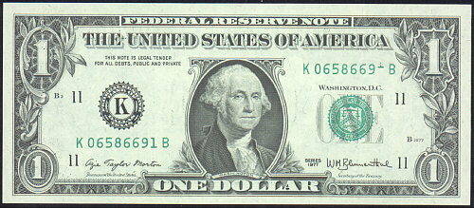
The Federal Reserve System was created in 1913 by Woodrow Wilson
The role of the Fed is to control the supply of currency, as well as regulate the banking system
In 1930s, every dollar the gov issues has 0.4$ worth of gold in the gov’s vault

Slide 11
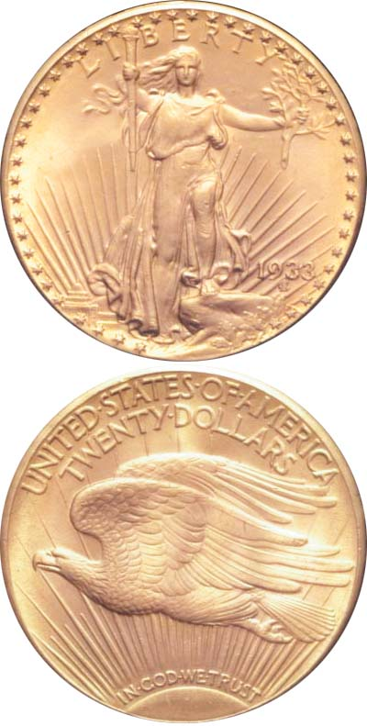
The Gold Reserve Act: 1934
In order to deal with the banking crisis, FDR orders US citizens (as well as the Fed) to surrender all gold coins, bullion, and certificates to the US Treasury

Slide 12
The Gold Reserve Act: 1934
Ownership of gold by US citizens was illegal until the law was repealed in 1974!

Slide 13
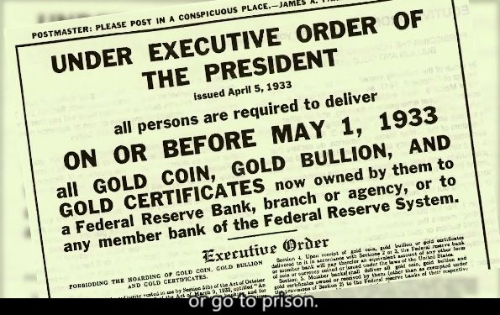
History of money

Slide 14
Nixon Closes the Gold Window
On August 15, 1971, Nixon closes the gold window and the US dollar ceases to be convertible into gold. This marks the beginning of the current anchorless system.

Slide 15
History of money
The mechanism of banking
The worldwide financial crisis
something new

Slide 16
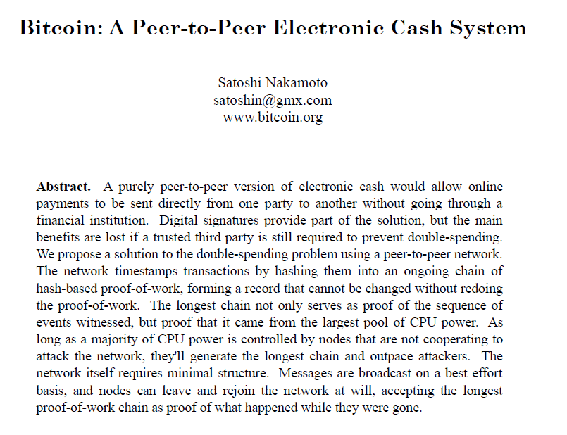
Bitcoin
Craig, Dorian, Hal, or Nick?
Electronic payment
system
P2P
No double
spending
Secure via
hash
Warning
about majority of
computing power
https://bitcoin.org/bitcoin.pdf
Published November 2008

Slide 17
Byzantine General Problem
How do you ensure that a peer-to-peer, distributed network with no central authority can make correct decisions, even if some of the nodes in it turn rogue?
Notes:
CAP理论是一个分布式系统最多只能同时满足一致性（Consistency）、可用性（Availability）和分区容忍性（Partition tolerance）这三项中的两项。
No completely asynchronous consensus protocol can tolerate even a single unannounced process death ( FLP impossibility )

Slide 18
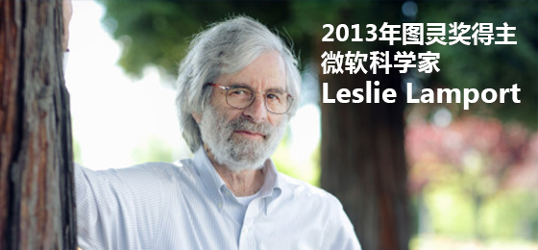
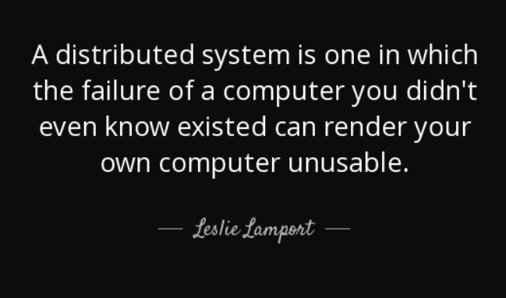

Slide 19
Byzantine General Problem
I have long felt that, because it was posed as a cute problem about philosophers seated around a table, Dijkstra’s dining philosopher’s problem received much more attention than it deserves. (For example, it has probably received more attention in the theory community than the readers/writers problem, which illustrates the same principles and has much more practical importance.) I believed that the problem introduced in [41] was very important and deserved the attention of computer scientists. The popularity of the dining philosophers problem taught me that the best way to attract attention to a problem is to present it in terms of a story.
There is a problem in distributed computing that is sometimes called the Chinese Generals Problem, in which two generals have to come to a common agreement on whether to attack or retreat, but can communicate only by sending messengers who might never arrive. I stole the idea of the generals and posed the problem in terms of a group of generals, some of whom may be traitors, who have to reach a common decision. I wanted to assign the generals a nationality that would not offend any readers. At the time, Albania was a completely closed society, and I felt it unlikely that there would be any Albanians around to object, so the original title of this paper was The Albanian Generals Problem. Jack Goldberg was smart enough to realize that there were Albanians in the world outside Albania, and Albania might not always be a black hole, so he suggested that I find another name. The obviously more appropriate Byzantine generals then occurred to me.
The main reason for writing this paper was to assign the new name to the problem. But a new paper needed new results as well. I came up with a simpler way to describe the general 3n+1-processor algorithm. (Shostak’s 4-processor algorithm was subtle but easy to understand; Pease’s generalization was a remarkable tour de force.) We also added a generalization to networks that were not completely connected. (I don’t remember whose work that was.) I also added some discussion of practical implementation details.
Notes:
https://www.microsoft.com/en-us/research/publication/byzantine-generals-problem/?from=http://research.microsoft.com/en-us/um/people/lamport/pubs/byz.pdf

Slide 20
Motivation
Coping with failures in computer systems
Failed component sends conflicting information to different parts of system.
Agreement in the presence of faults.
P2P Networks?
Good nodes have to “agree to do the same thing”.
Faulty nodes generate corrupted and misleading messages.
Non-malicious: Software bugs, hardware failures, power failures
Malicious reasons: Machine compromised.

Slide 21
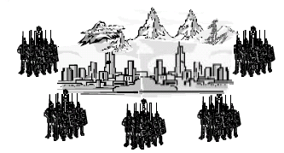
Problem Definition
Generals = Computer Components
The abstract problem…
Each division of Byzantine army is directed by its own general.
There are n Generals, some of which are traitors.
All armies are camped outside enemy castle, observing enemy.
Communicate with each other by messengers.
Requirements:
G1: All loyal generals decide upon the same plan of action
G2: A small number of traitors cannot cause the loyal generals to adopt a bad plan
Note: We do not have to identify the traitors.

Slide 22
Byzantine General Problem
Conclusion:
generals can reach consensus with less than 1/3 traitors
After receiving a message, generals will communicate with each other
Example: 4 generals A B C D
Case1: General A sends message “attack at 1 pm” to the other 3 generals (one of B C D is traitor)
Case2: General A sends message “attack at 1 pm” “attack at 2 pm” “attack at 3 pm” to B C D respectively (A is traitor)

Slide 23
Proof of Work
What is needed is an electronic payment system based on cryptographic proof instead of trust, allowing any two willing parties to transact directly with each other without the need for a trusted third party. Transactions that are computationally impractical to reverse would protect sellers from fraud, and routine escrow mechanisms could easily be implemented to protect buyers. In this paper, we propose a solution to the double-spending problem using a peer-to-peer distributed timestamp server to generate computational proof of the chronological order of transactions. The system is secure as long as honest nodes collectively control more CPU power than any cooperating group of attacker nodes.

Slide 24
Proof of Work
To implement a distributed timestamp server on a peer-to-peer basis, we will need to use a proof-of-work system similar to Adam Back's Hashcash , rather than newspaper or Usenet posts. The proof-of-work involves scanning for a value that when hashed, such as with SHA-256, the hash begins with a number of zero bits. The average work required is exponential in the number of zero bits required and can be verified by executing a single hash.

Slide 25
Proof of Work
The proof-of-work also solves the problem of determining representation in majority decision making. If the majority were based on one-IP-address-one-vote, it could be subverted by anyone able to allocate many IPs. Proof-of-work is essentially one-CPU-one-vote. The majority decision is represented by the longest chain, which has the greatest proof-of-work effort invested in it. If a majority of CPU power is controlled by honest nodes, the honest chain will grow the fastest and outpace any competing chains. To modify a past block, an attacker would have to redo the proof-of-work of the block and all blocks after it and then catch up with and surpass the work of the honest nodes.

Slide 26
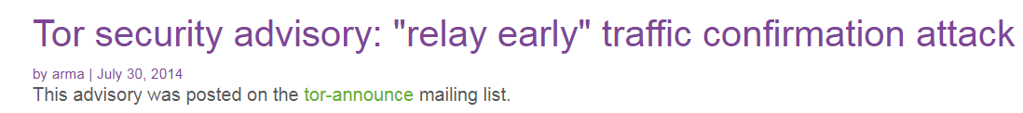
Proof of Work
Sybil attack, the attacker subverts the reputation system of a network service by creating a large number of pseudonymous identities and uses them to gain a disproportionately large influence.
Notes:
https://blog.torproject.org/tor-security-advisory-relay-early-traffic-confirmation-attack
We believe they used a combination of two classes of attacks: a traffic confirmation attack and a Sybil attack

Slide 27
Proof of Work
Hashcash is a proof-of-work algorithm, which has been used as a denial-of-service counter measure technique in a number of systems.
A hashcash stamp constitutes a proof-of-work which takes a parameterizable amount of work to compute for the sender. The recipient (and indeed anyone as it is publicly auditable) can verify received hashcash stamps efficiently
At this point it is most widely used as the bitcoin mining function.

Slide 28
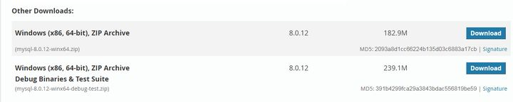
Hash
What is Hash?
Give an example of hash algorithm
Give an application example of hash
Notes:
XcodeGhost, discovered in September 2015, spread through altered copies of Apple’s Xcode development environment, and, when iOS apps were compiled, third-party code was injected into those apps. Users downloaded infected apps from the iOS App Store, and more than 100 million users were affected.
Most of these apps were developed in China, and it is thought that people downloaded these compromised versions of Xcode because it was "faster to download than the free, official version on Apple’s App Store."

Slide 29
Hash
A hash function is a mathematical function with the following three properties:
Its input can be any string of any size.
It produces a fixed size output, For example, SHA-256 has an output size of 256‐bit. (question: does the output size matter?)
It is efficiently computable. Intuitively this means that for a given input string, you can figure out what the output of the hash function is in a reasonable amount of time. More technically, computing the hash of an n ‐bit string should have a running time that is O( n ).

Slide 30
Hash
A cryptographic hash function
collision‐resistance
Hiding
puzzle‐friendliness
Examples: SHA256, SHA512, SHA3-256, RIPEMD-160

Slide 31
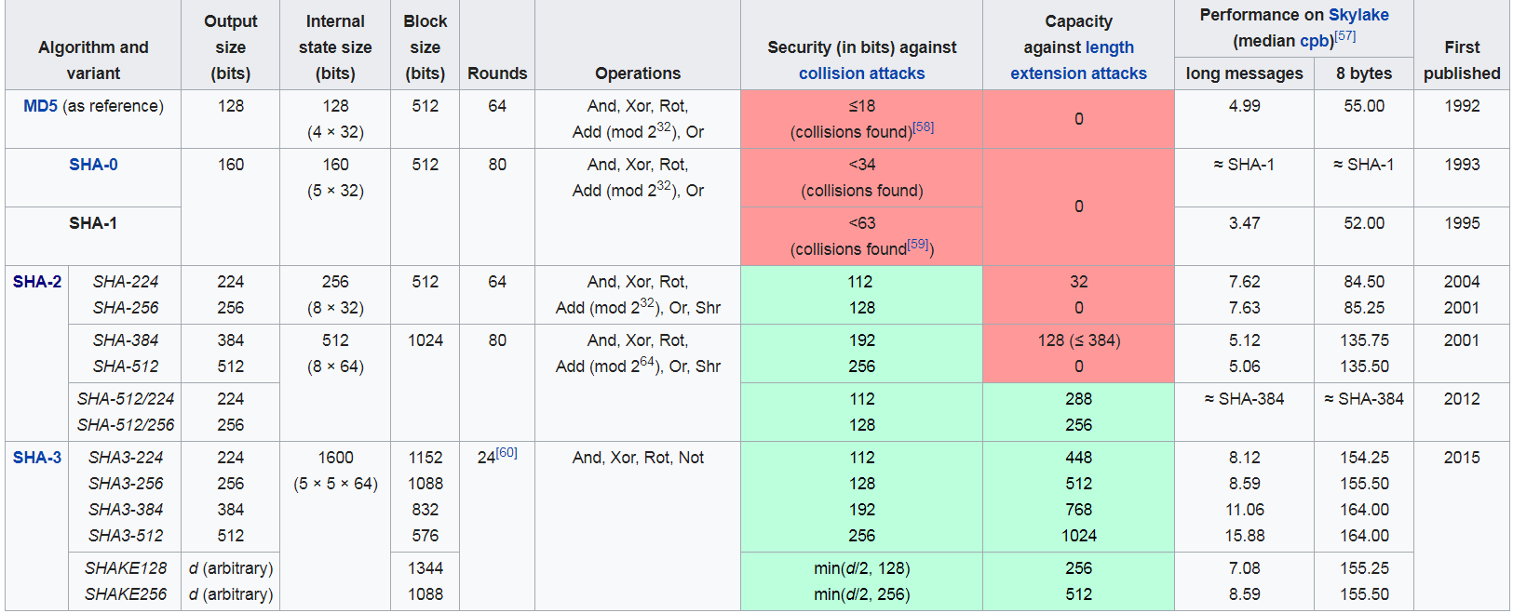
Hash

Slide 32
Hash
Hiding :
The hiding property asserts that if we’re given the output of the hash function y = H(x) , there’s no feasible way to figure out what the input, x , was.
A hash function H is hiding if: when a secret value r is chosen from a probability distribution that has high min‐entropy , then given H(r ‖ x) it is infeasible to find x .

Slide 33
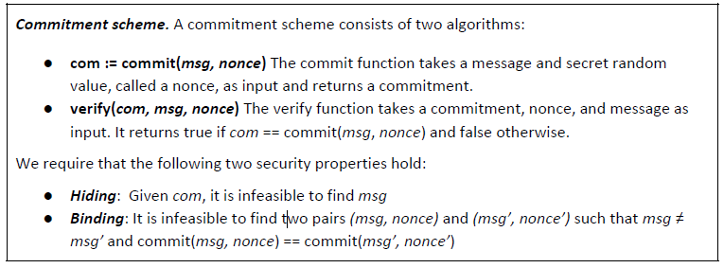
Hash
Hiding
exmaple
World cup competition
Bet the final result
Don’t want to reveal one’s prediction

Slide 34
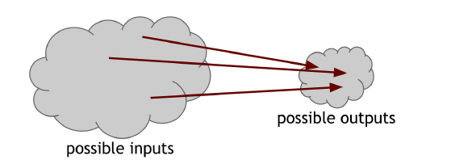
Hash
Collision‐resistance
Collision‐resistance: A hash function H is said to be collision resistant if it is infeasible to find two values, x and y , such that x ≠ y , yet H(x) = H(y)
Notice that we said nobody can find a collision, but we did not say that no collisions exist
the input space is larger than the output space (indeed, theinput space is infinite, while the output space is finite), there must be input strings that map to the same output string
Pigeonhole principle

Slide 35
Hash
Collision‐resistance
Birthday paradox
If we randomly choose just 2^130 + 1 inputs, it turns out there’s a 99.8% chance that at least two of them are going to collide
However, if a computer calculates 10,000 hashes per second, it would take more than one octillion (10^27 ) years to calculate 2^128 hashes
The odds that to find a collision is still infinitesimally small. So small that it’s way less than the odds that the Earth will be destroyed by a giant meteor in the next two seconds.
Notes:
In probability theory, the birthday problem or birthday paradox concerns the probability that, in a set of n randomly chosen people, some pair of them will have the same birthday. In a group of 23 people, the probability of a shared birthday exceeds 50%, while a group of 70 has a 99.9% chance of a shared birthday.

Slide 36
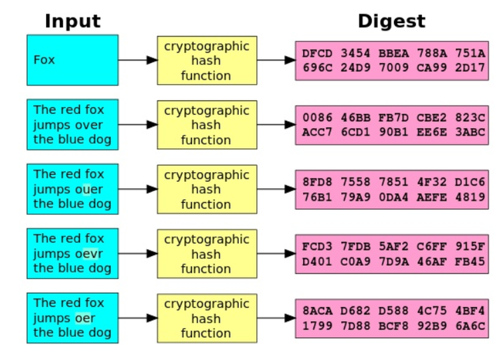
avalanche

Slide 37
Hash
Puzzle friendliness.
A hash function H is said to be puzzle‐friendly if for every possible n‐bit output value y , if k is chosen from a distribution with high min‐entropy, then it is infeasible to find x such that H(k ||x) = y in time significantly less than 2^n .
Search puzzle

Slide 38

Hash
Mining
In order to create a block, the node that proposes that block is required to find a number, or nonce , such that when you concatenate the nonce, the previous hash, and the list of transactions that comprise that block and take the hash of this whole string, then that hash output should be a number that falls into a target space that is quite small in relation to the much larger output space of that hash function

Slide 39
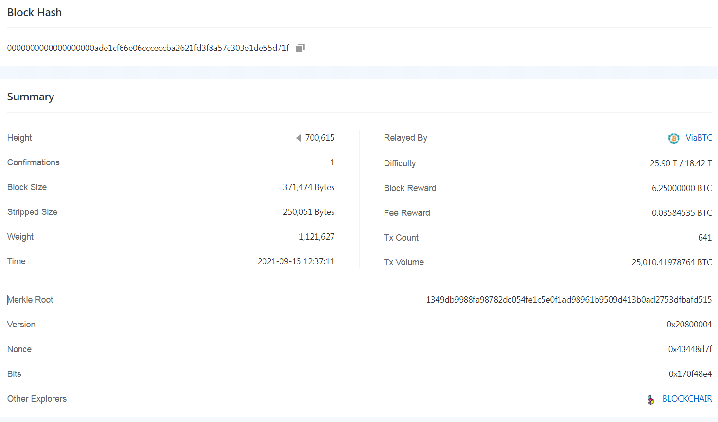
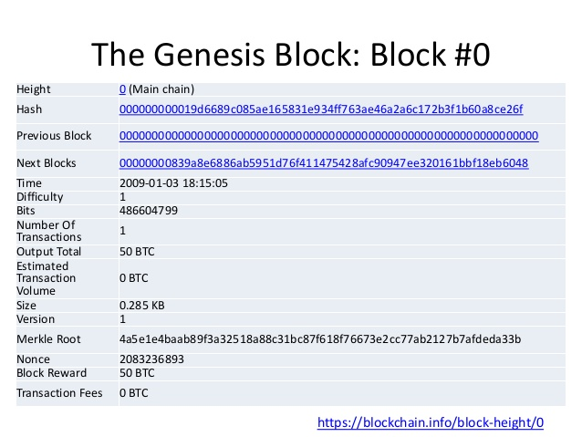

Slide 40
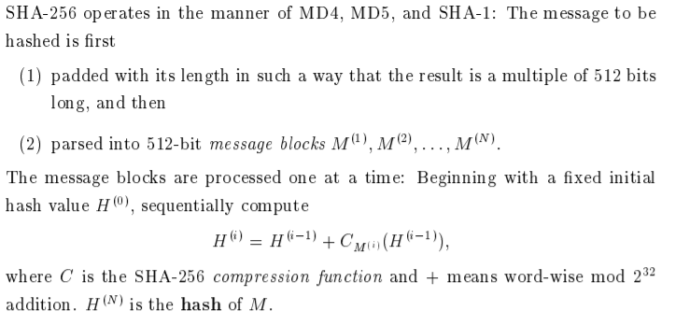
SHA-256
The message to be hashed is
first padded with its length in such a way that the result is a multiple of 512 bits long, and then
parsed into 512-bit message blocks M1,M2…..
The message blocks are processed one at a time:

Slide 41
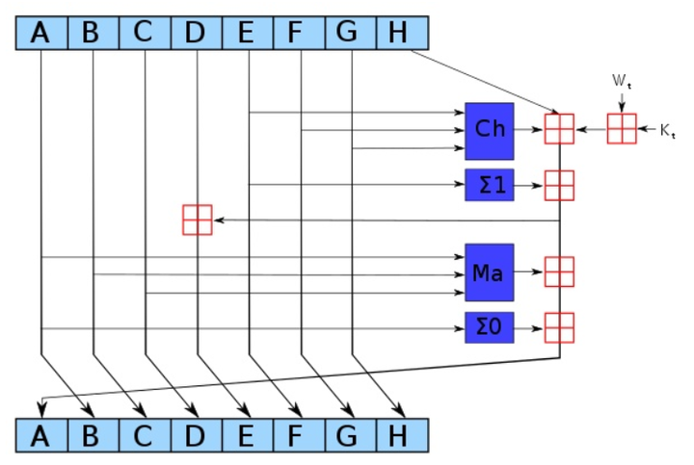

Hash
SHA-256
One iteration
64 rounds
Notes:
这里A～H共有8个，初始值分别是
h0 := 0x6a09e667 h1 := 0xbb67ae85 h2 := 0x3c6ef372 h3 := 0xa54ff53a h4 := 0x510e527f h5 := 0x9b05688c h6 := 0x1f83d9ab h7 := 0x5be0cd19
分别是8个16进制数，所以总共有256位，这个就叫做初始向量（IV）。这8个数是前8个素数取平方根，前32位小数。最终生成的哈希值也是这么长，所以，每一轮的计算就是如上图所示，更新这8个值。
每一轮计算64次。在上图中可以看到，除了A～H外，有两个输入，分别是 w_{t} 和 k_{t} 。也即每一轮中有64个 w ，以及64个 k 。每个 w 长度为32bit，也即4个字节。64个 w 来自于哈希函数的输入，也即，对于输入，不论长短，长的就分成每512bit一个块（64个字节），短的补足512bit。这64个字节构成了前16个 w ，后面的48个 w 通过前面的16个生成。
for i from 16 to 63
s0 := (w[i-15] rightrotate 7) xor (w[i-15] rightrotate 18) xor (w[i-15] rightshift 3)
s1 := (w[i-2] rightrotate 17) xor (w[i-2] rightrotate 19) xor (w[i-2] rightshift 10)
w[i] := w[i-16] + s0 + w[i-7] + s1
64个 k 是64个常量，
k[0..63] := 0x428a2f98, 0x71374491, 0xb5c0fbcf, 0xe9b5dba5, 0x3956c25b, 0x59f111f1, 0x923f82a4, 0xab1c5ed5, 0xd807aa98, 0x12835b01, 0x243185be, 0x550c7dc3, 0x72be5d74, 0x80deb1fe, 0x9bdc06a7, 0xc19bf174, 0xe49b69c1, 0xefbe4786, 0x0fc19dc6, 0x240ca1cc, 0x2de92c6f, 0x4a7484aa, 0x5cb0a9dc, 0x76f988da, 0x983e5152, 0xa831c66d, 0xb00327c8, 0xbf597fc7, 0xc6e00bf3, 0xd5a79147, 0x06ca6351, 0x14292967, 0x27b70a85, 0x2e1b2138, 0x4d2c6dfc, 0x53380d13, 0x650a7354, 0x766a0abb, 0x81c2c92e, 0x92722c85, 0xa2bfe8a1, 0xa81a664b, 0xc24b8b70, 0xc76c51a3, 0xd192e819, 0xd6990624, 0xf40e3585, 0x106aa070, 0x19a4c116, 0x1e376c08, 0x2748774c, 0x34b0bcb5, 0x391c0cb3, 0x4ed8aa4a, 0x5b9cca4f, 0x682e6ff3, 0x748f82ee, 0x78a5636f, 0x84c87814, 0x8cc70208, 0x90befffa, 0xa4506ceb, 0xbef9a3f7, 0xc67178f2
这64个常量来自于自然数中前64个质数{2,3,5,7,11,13,17,19,23,29,31,37,41,43,47,53,59,61,67,71,73,79,83,89,97…}，取立方根

Slide 42
SHA-256
first 32 bits of the fractional parts of the square roots of the first 8 primes 2..19
A h0 := 0x6a09e667 B h1 := 0xbb67ae85 C h2 := 0x3c6ef372 D h3 := 0xa54ff53a E h4 := 0x510e527f F h5 := 0x9b05688c G h6 := 0x1f83d9ab H h7 := 0x5be0cd19

Slide 43
SHA-256
first 32 bits of the fractional parts of the cube roots of the first 64 primes 2..311):
k[0..63] := 0x428a2f98, 0x71374491, 0xb5c0fbcf, 0xe9b5dba5, 0x3956c25b, 0x59f111f1, 0x923f82a4, 0xab1c5ed5, 0xd807aa98, 0x12835b01, 0x243185be, 0x550c7dc3, 0x72be5d74, 0x80deb1fe, 0x9bdc06a7, 0xc19bf174, 0xe49b69c1, 0xefbe4786, 0x0fc19dc6, 0x240ca1cc, 0x2de92c6f, 0x4a7484aa, 0x5cb0a9dc, 0x76f988da, 0x983e5152, 0xa831c66d, 0xb00327c8, 0xbf597fc7, 0xc6e00bf3, 0xd5a79147, 0x06ca6351, 0x14292967, 0x27b70a85, 0x2e1b2138, 0x4d2c6dfc, 0x53380d13, 0x650a7354, 0x766a0abb, 0x81c2c92e, 0x92722c85, 0xa2bfe8a1, 0xa81a664b, 0xc24b8b70, 0xc76c51a3, 0xd192e819, 0xd6990624, 0xf40e3585, 0x106aa070, 0x19a4c116, 0x1e376c08, 0x2748774c, 0x34b0bcb5, 0x391c0cb3, 0x4ed8aa4a, 0x5b9cca4f, 0x682e6ff3, 0x748f82ee, 0x78a5636f, 0x84c87814, 0x8cc70208, 0x90befffa, 0xa4506ceb, 0xbef9a3f7, 0xc67178f2

Slide 44
Extend the first 16 words into the remaining 48 words w[16..63] of the message schedule array:
for i from 16 to 63
s0 := (w[i-15] rightrotate 7) xor (w[i-15] rightrotate 18) xor (w[i-15] rightshift 3)
s1 := (w[i- 2] rightrotate 17) xor (w[i- 2] rightrotate 19) xor (w[i- 2] rightshift 10)
w[i] := w[i-16] + s0 + w[i-7] + s1

Slide 45
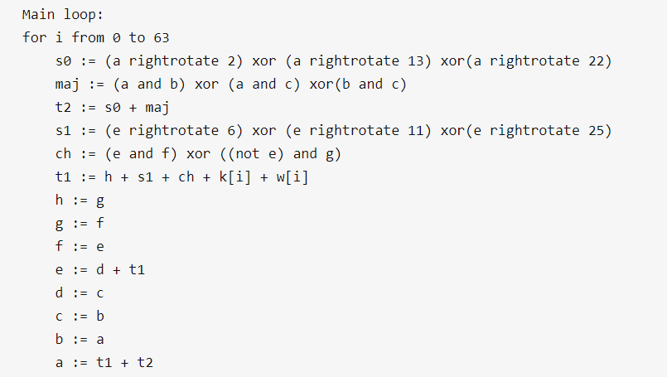

Slide 46
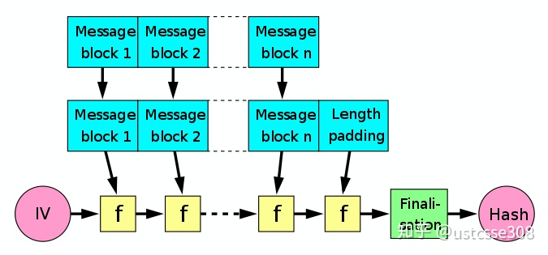
SHA-256

Slide 47
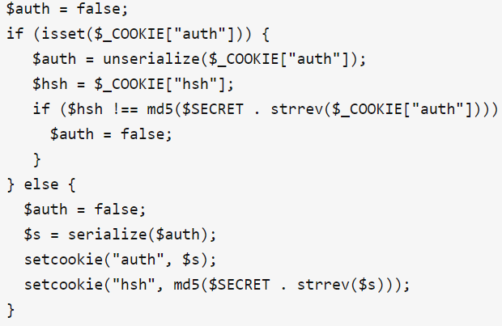
length extension attack
Cookie: auth=root; hsh=32efdc967fcaebc6853b75cacfb80c5f

Slide 48
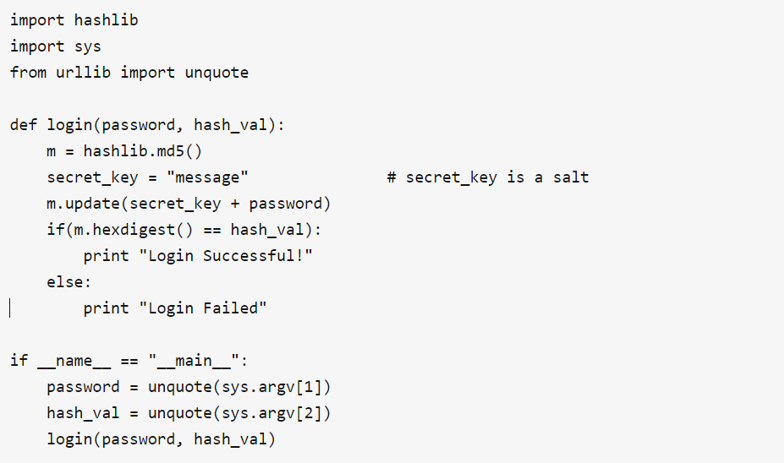
Length extension attack
Code in python

Slide 49
Attack: step by step
Let's look at a step-by-step example. For this example:
let secret = “message"
let data = “root"
let H = md5()
let signature = hash(secret || data) = md5(“messageroot”) = f3c36e01c874865bc081e4ae7af037ea
let append = "append"

Slide 50
Attack: step by step
Padding
0000 6D 65 73 73 61 67 65 72 6f 6f 74 80 00 00 00 00 messageroot.....
0010 00 00 00 00 00 00 00 00 00 00 00 00 00 00 00 00 . . ..............
0020 00 00 00 00 00 00 00 00 00 00 00 00 00 00 00 00 ................ ...
0030 00 00 00 00 00 00 00 00 58 00 00 00 00 00 00 00 ........X.......
When calculating H(secret + data), the string (secret + data) is padded with a '1' bit and some number of '0' bits, followed by the length of the string
the string is padded until its length is congruent to 56 bytes (mod 64). Or, to put it another way, it's padded until the length is 8 bytes less than a full (64-byte) block (the 8 bytes being size of the encoded length field)

Slide 51
Attack: step by step
Breaking down the string, we have:
"secret" = message
"data" = root
80 00 00 ... — The 45 bytes of padding, starting with 0x80
58 00 00 00 00 00 00 00 — The bit length in little endian

Slide 52
Attack: step by step
let's just append append to the string
0000 6D 65 73 73 61 67 65 72 6f 6f 74 80 00 00 00 00 messageroot.....
0010 00 00 00 00 00 00 00 00 00 00 00 00 00 00 00 00 . . ..............
0020 00 00 00 00 00 00 00 00 00 00 00 00 00 00 00 00 ................ ...
0030 00 00 00 00 00 00 00 00 58 00 00 00 00 00 00 00 ........X.......
0040 61 70 70 65 6e 64 append

